Slide 1
File-System Interface

Slide 2
File Concept
Contiguous logical address space
Types:
Data
numeric
character
binary
Program
Contents defined by file’s creator
Many types
Consider text file, source file, executable file

Slide 3
File Attributes
Name – only information kept in human-readable form
Identifier – unique tag (number) identifies file within file system
Type – needed for systems that support different types
Location – pointer to file location on device
Size – current file size
Protection – controls who can do reading, writing, executing
Time, date, and user identification – data for protection, security, and usage monitoring
Information about files are kept in the directory structure, which is maintained on the disk
Many variations, including extended file attributes such as file checksum
Information kept in the directory structure

Slide 4
File Operations
File is an abstract data type
Create
Write – at write pointer location
Read – at read pointer location
Reposition within file - seek
Delete
Truncate
Open(F_{i}) – search the directory structure on disk for entry F_{i}, and move the content of entry to memory
Close (F_{i}) – move the content of entry F_{i} in memory to directory structure on disk
Notes:
‹#›

Slide 5
Open Files
Several pieces of data are needed to manage open files:
Open-file table: tracks open files
File pointer: pointer to last read/write location, per process that has the file open
File-open count: counter of number of times a file is open – to allow removal of data from open-file table when last processes closes it
Disk location of the file: cache of data access information
Access rights: per-process access mode information
Notes:
‹#›

Slide 6
Open File Locking
Provided by some operating systems and file systems
Similar to reader-writer locks
Shared lock similar to reader lock – several processes can acquire concurrently
Exclusive lock similar to writer lock
Mediates access to a file
Mandatory or advisory:
Mandatory – access is denied depending on locks held and requested
Advisory – processes can find status of locks and decide what to do
Notes:
‹#›

Slide 7
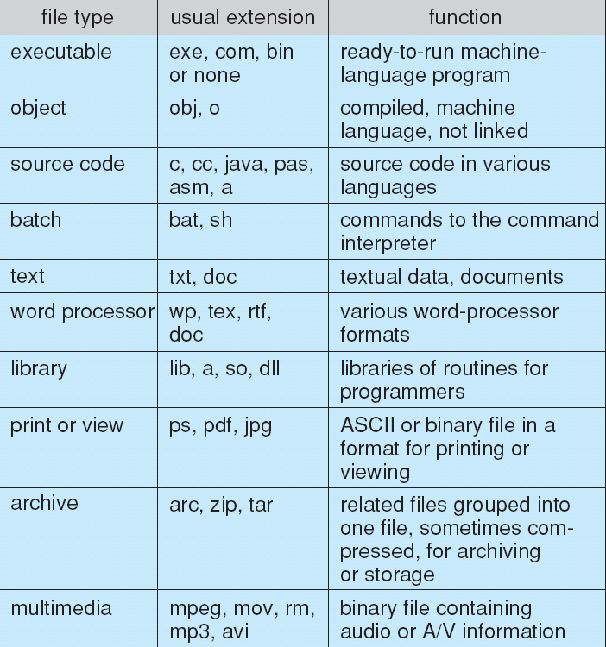
File Types – Name, Extension
Notes:
‹#›

Slide 8
File Structure
None - sequence of words, bytes
Simple record structure
Lines
Fixed length
Variable length
Complex Structures
Formatted document
Relocatable load file
Can simulate last two with first method by inserting appropriate control characters
Who decides:
Operating system
Program
Notes:
‹#›

Slide 9
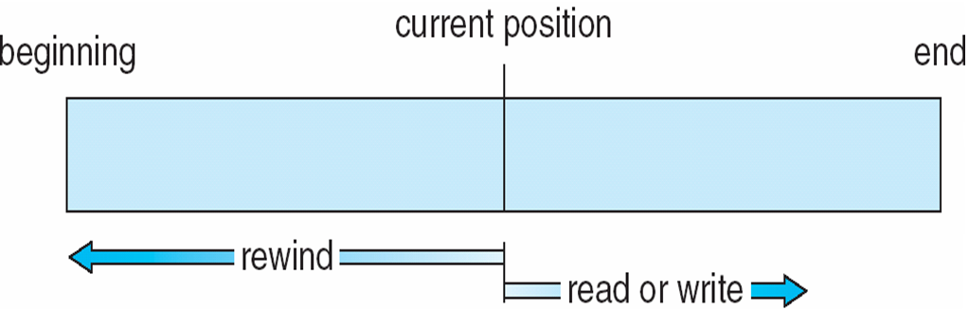
Sequential-access File
Notes:
‹#›

Slide 10
Access Methods
Sequential Access
read next
write next
reset
no read after last write
(rewrite)
Direct Access – file is fixed length logical records
read n
write n
position to n
read next
write next
rewrite n
n = relative block number
Relative block numbers allow OS to decide where file should be placed
See allocation problem in Ch 12

Slide 11
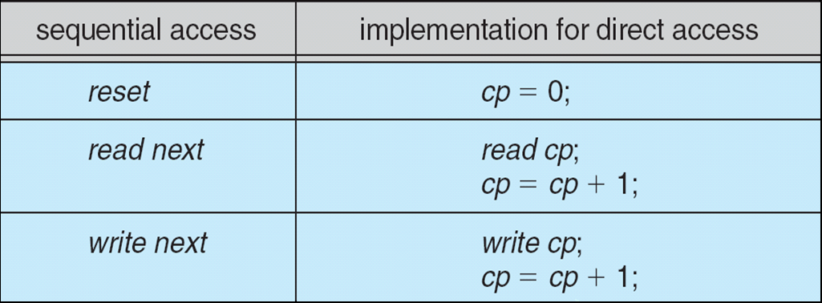
Simulation of Sequential Access on Direct-access File

Slide 12
Other Access Methods
Can be built on top of base methods
General involve creation of an index for the file
Keep index in memory for fast determination of location of data to be operated on (consider UPC code plus record of data about that item)
If too large, index (in memory) of the index (on disk)
IBM indexed sequential-access method (ISAM)
Small master index, points to disk blocks of secondary index
File kept sorted on a defined key
All done by the OS
VMS operating system provides index and relative files as another example (see next slide)
Notes:
‹#›

Slide 13
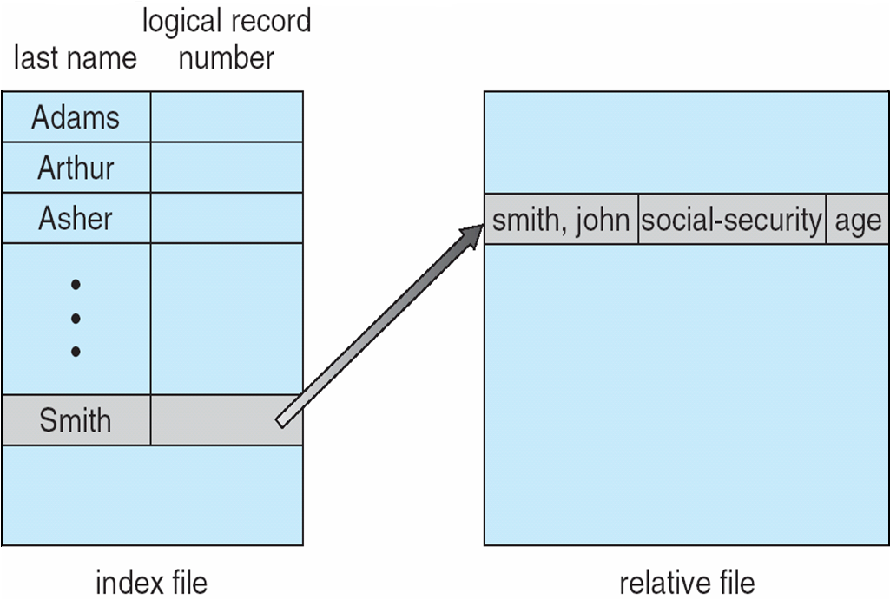
Example of Index and Relative Files
Notes:
‹#›

Slide 14
Directory Structure
A collection of nodes containing information about all files
Directory
Files
F 1
F 2
F 3
F 4
F n
Both the directory structure and the files reside on disk
Notes:
‹#›

Slide 15
Disk Structure
Disk can be subdivided into partitions
Disks or partitions can be RAID protected against failure
Disk or partition can be used raw – without a file system, or formatted with a file system
Partitions also known as minidisks, slices
Entity containing file system known as a volume
Each volume containing file system also tracks that file system’s info in device directory or volume table of contents
As well as general-purpose file systems there are many special-purpose file systems, frequently all within the same operating system or computer
Notes:
‹#›

Slide 16
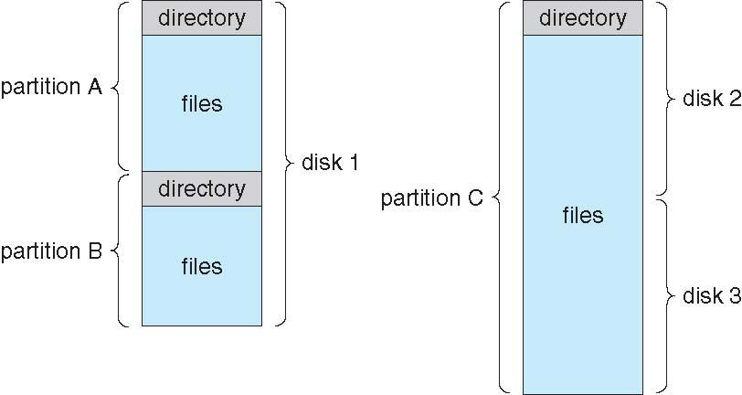
A Typical File-system Organization
Notes:
‹#›

Slide 17
Types of File Systems
We mostly talk of general-purpose file systems
But systems frequently have may file systems, some general- and some special- purpose
Consider Solaris has
tmpfs – memory-based volatile FS for fast, temporary I/O
objfs – interface into kernel memory to get kernel symbols for debugging
ctfs – contract file system for managing daemons
lofs – loopback file system allows one FS to be accessed in place of another
procfs – kernel interface to process structures
ufs, zfs – general purpose file systems
Notes:
‹#›

Slide 18
Operations Performed on Directory
Search for a file
Create a file
Delete a file
List a directory
Rename a file
Traverse the file system
Notes:
‹#›

Slide 19
Directory Organization
The directory is organized logically to obtain
Efficiency – locating a file quickly
Naming – convenient to users
Two users can have same name for different files
The same file can have several different names
Grouping – logical grouping of files by properties, (e.g., all Java programs, all games, …)

Slide 20
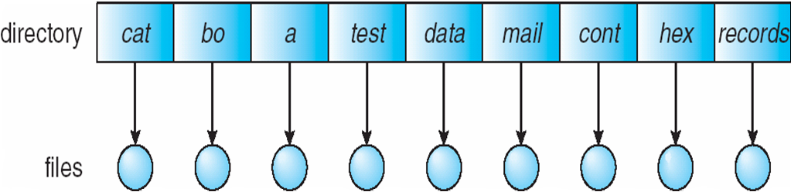
Single-Level Directory
A single directory for all users
Naming problem
Grouping problem
Notes:
‹#›

Slide 21
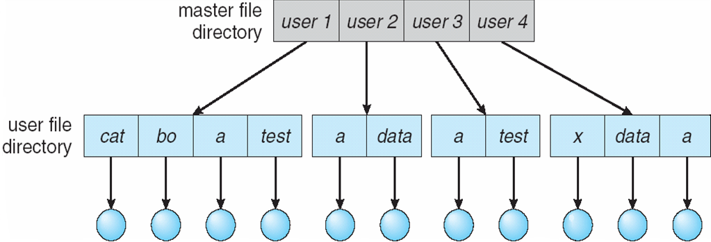
Two-Level Directory
Separate directory for each user
Path name
Can have the same file name for different user
Efficient searching
No grouping capability
Notes:
‹#›

Slide 22
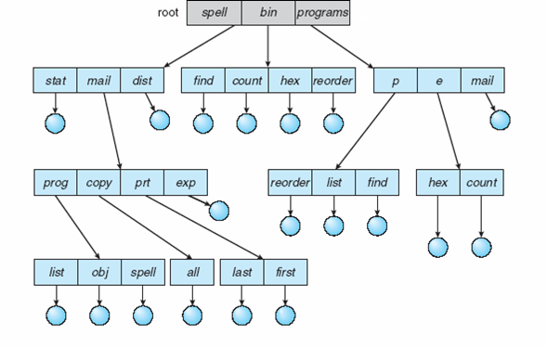
Tree-Structured Directories
Notes:
‹#›

Slide 23
Tree-Structured Directories (Cont.)
Efficient searching
Grouping Capability
Current directory (working directory)
cd /spell/mail/prog
type list
Notes:
‹#›

Slide 24
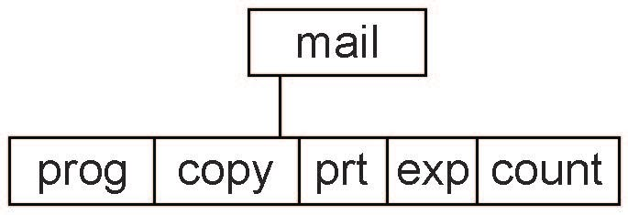
Tree-Structured Directories (Cont)
Absolute or relative path name
Creating a new file is done in current directory
Delete a file
rm <file-name>
Creating a new subdirectory is done in current directory
mkdir <dir-name>
Example: if in current directory /mail
mkdir count
Deleting “mail” ⇒ deleting the entire subtree rooted by “mail”
Notes:
‹#›

Slide 25
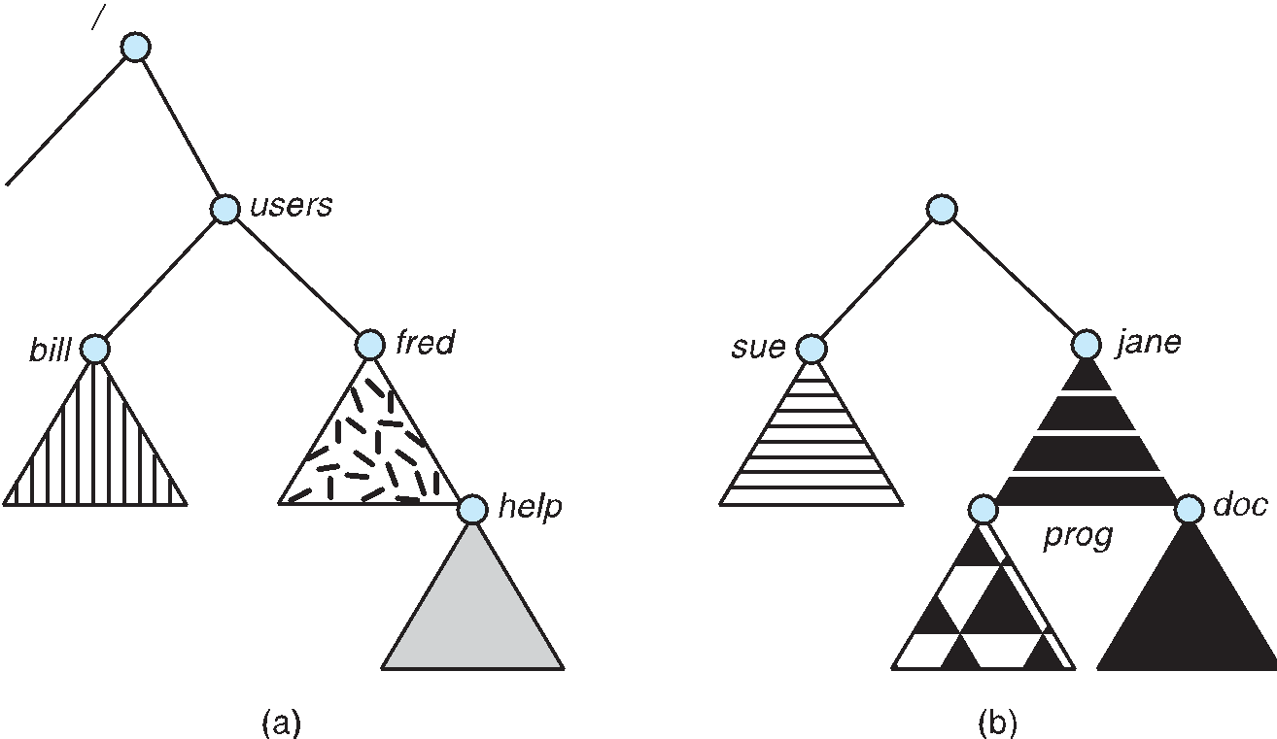
File System Mounting
A file system must be mounted before it can be accessed
A unmounted file system (i.e., Fig. 11-11(b)) is mounted at a mount point
Notes:
‹#›

Slide 26
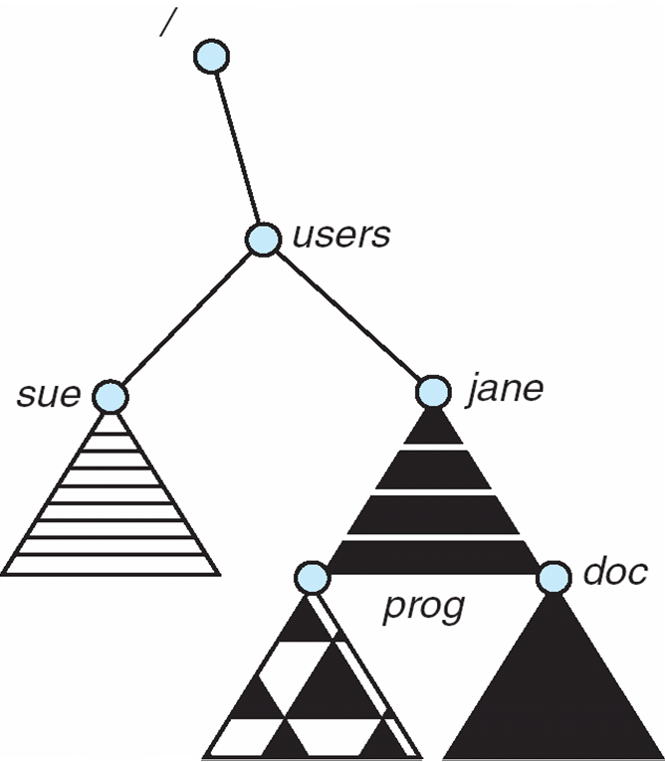
Mount Point
Notes:
‹#›

Slide 27
Protection
File owner/creator should be able to control:
what can be done
by whom
Types of access
Read
Write
Execute
Append
Delete
List

Slide 28
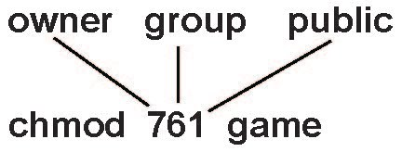
Access Lists and Groups
Mode of access: read, write, execute
Three classes of users on Unix / Linux
RWX
a) owner access 7 ⇒ 1 1 1 RWX
b) group access 6 ⇒ 1 1 0
RWX
c) public access 1 ⇒ 0 0 1
Ask manager to create a group (unique name), say G, and add some users to the group.
For a particular file (say game) or subdirectory, define an appropriate access.
Attach a group to a file chgrp G game

Slide 29
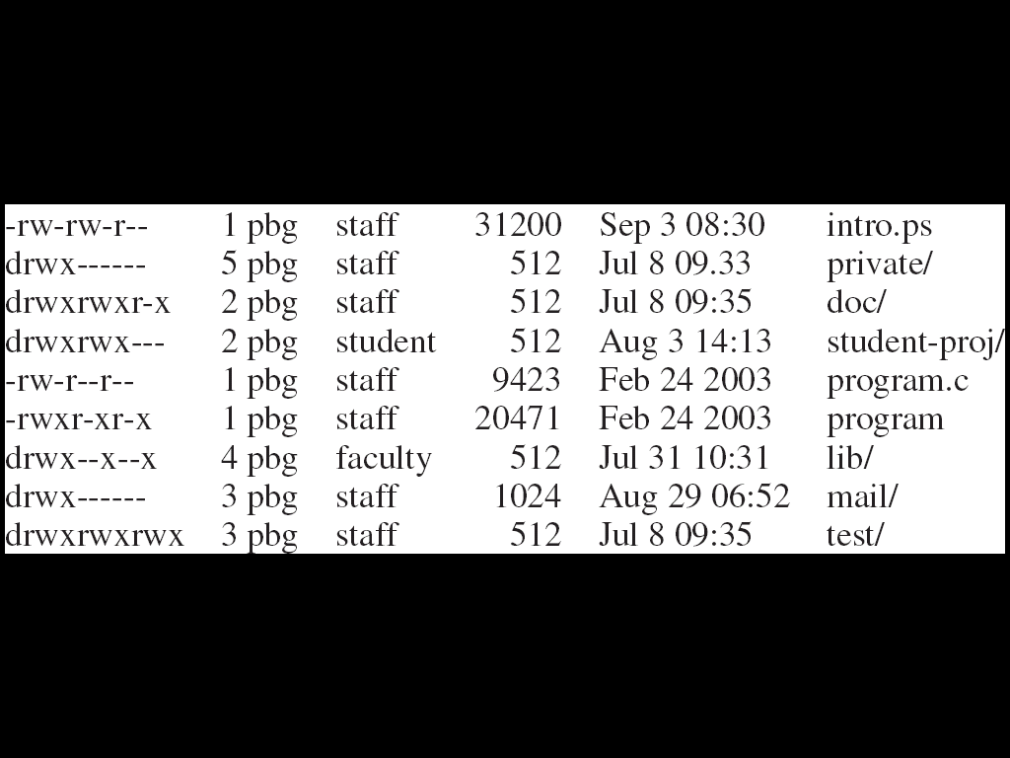
A Sample UNIX Directory Listing

Slide 30
File System Implementation

Slide 31
File-System Structure
File structure
Logical storage unit
Collection of related information
File system resides on secondary storage (disks)
Provided user interface to storage, mapping logical to physical
Provides efficient and convenient access to disk by allowing data to be stored, located retrieved easily
Disk provides in-place rewrite and random access
I/O transfers performed in blocks of sectors (usually 512 bytes)
File control block – storage structure consisting of information about a file
Device driver controls the physical device
File system organized into layers
Notes:
‹#›

Slide 32
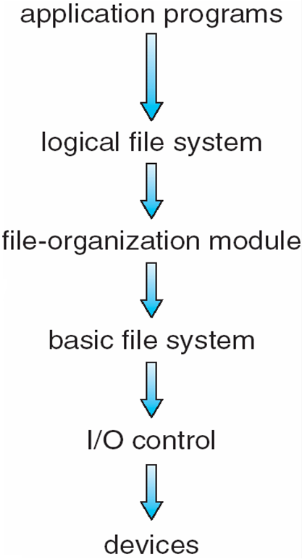
Layered File System

Slide 33
File System Layers
Device drivers manage I/O devices at the I/O control layer
Given commands like “read drive1, cylinder 72, track 2, sector 10, into memory location 1060” outputs low-level hardware specific commands to hardware controller
Basic file system given command like “retrieve block 123” translates to device driver
Also manages memory buffers and caches (allocation, freeing, replacement)
Buffers hold data in transit
Caches hold frequently used data
File organization module understands files, logical address, and physical blocks
Translates logical block # to physical block #
Manages free space, disk allocation

Slide 34
File System Layers (Cont.)
Logical file system manages metadata information
Translates file name into file number, file handle, location by maintaining file control blocks (inodes in UNIX)
Directory management
Protection
Layering useful for reducing complexity and redundancy, but adds overhead and can decrease performanceTranslates file name into file number, file handle, location by maintaining file control blocks (inodes in UNIX)
Logical layers can be implemented by any coding method according to OS designer

Slide 35
File System Layers (Cont.)
Many file systems, sometimes many within an operating system
Each with its own format (CD-ROM is ISO 9660; Unix has UFS, FFS; Windows has FAT, FAT32, NTFS as well as floppy, CD, DVD Blu-ray, Linux has more than 40 types, with extended file system ext2 and ext3 leading; plus distributed file systems, etc.)
New ones still arriving – ZFS, GoogleFS, Oracle ASM, FUSE

Slide 36
File-System Implementation
We have system calls at the API level, but how do we implement their functions?
On-disk and in-memory structures
Boot control block contains info needed by system to boot OS from that volume
Needed if volume contains OS, usually first block of volume
Volume control block (superblock, master file table) contains volume details
Total # of blocks, # of free blocks, block size, free block pointers or array
Directory structure organizes the files
Names and inode numbers, master file table
Notes:
‹#›

Slide 37
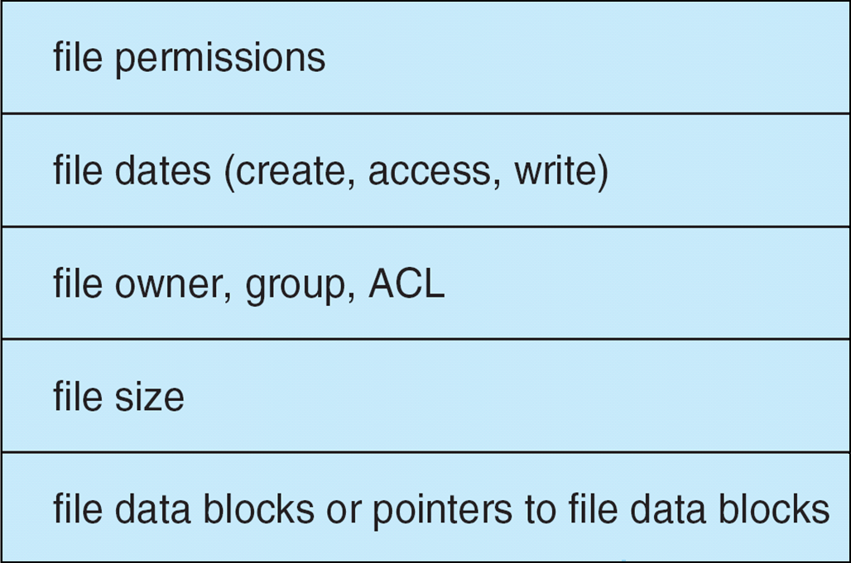
File-System Implementation (Cont.)
Per-file File Control Block (FCB) contains many details about the file
inode number, permissions, size, dates
NFTS stores into in master file table using relational DB structures

Slide 38
In-Memory File System Structures
Mount table storing file system mounts, mount points, file system types
The following figure illustrates the necessary file system structures provided by the operating systems
Figure 12-3(a) refers to opening a file
Figure 12-3(b) refers to reading a file
Plus buffers hold data blocks from secondary storage
Open returns a file handle for subsequent use
Data from read eventually copied to specified user process memory address

Slide 39
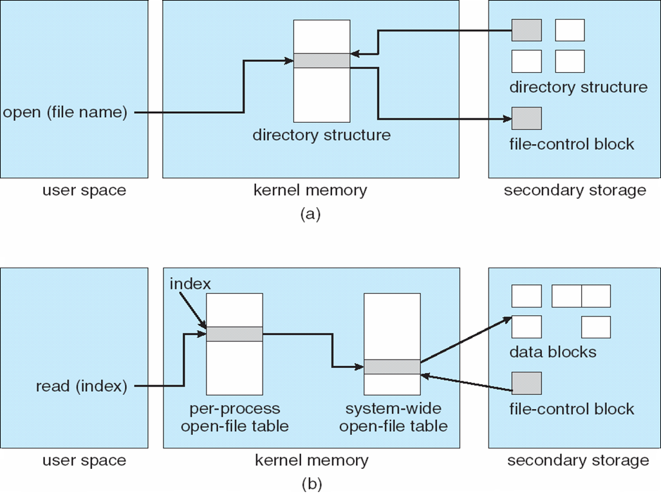
In-Memory File System Structures

Slide 40
Partitions and Mounting
Partition can be a volume containing a file system (“cooked”) or raw – just a sequence of blocks with no file system
Boot block can point to boot volume or boot loader set of blocks that contain enough code to know how to load the kernel from the file system
Or a boot management program for multi-os booting
Root partition contains the OS, other partitions can hold other Oses, other file systems, or be raw
Mounted at boot time
Other partitions can mount automatically or manually
At mount time, file system consistency checked
Is all metadata correct?
If not, fix it, try again
If yes, add to mount table, allow access

Slide 41
Virtual File Systems
Virtual File Systems (VFS) on Unix provide an object-oriented way of implementing file systems
VFS allows the same system call interface (the API) to be used for different types of file systems
Separates file-system generic operations from implementation details
Implementation can be one of many file systems types, or network file system
Implements vnodes which hold inodes or network file details
Then dispatches operation to appropriate file system implementation routines

Slide 42
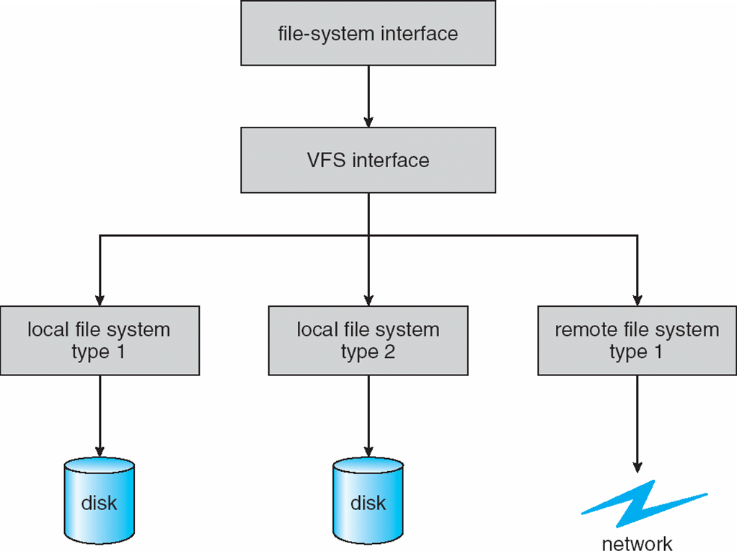
Virtual File Systems (Cont.)
The API is to the VFS interface, rather than any specific type of file system

Slide 43
Virtual File System Implementation
For example, Linux has four object types:
inode, file, superblock, dentry
VFS defines set of operations on the objects that must be implemented
Every object has a pointer to a function table
Function table has addresses of routines to implement that function on that object
For example:
• int open(. . .)—Open a file
• int close(. . .)—Close an already-open file
• ssize t read(. . .)—Read from a file
• ssize t write(. . .)—Write to a file
• int mmap(. . .)—Memory-map a file

Slide 44
Directory Implementation
Linear list of file names with pointer to the data blocks
Simple to program
Time-consuming to execute
Linear search time
Could keep ordered alphabetically via linked list or use B+ tree
Hash Table – linear list with hash data structure
Decreases directory search time
Collisions – situations where two file names hash to the same location
Only good if entries are fixed size, or use chained-overflow method
Notes:
‹#›

Slide 45
Allocation Methods - Contiguous
An allocation method refers to how disk blocks are allocated for files:
Contiguous allocation – each file occupies set of contiguous blocks
Best performance in most cases
Simple – only starting location (block #) and length (number of blocks) are required
Problems include finding space for file, knowing file size, external fragmentation, need for compaction off-line (downtime) or on-line
Notes:
‹#›

Slide 46
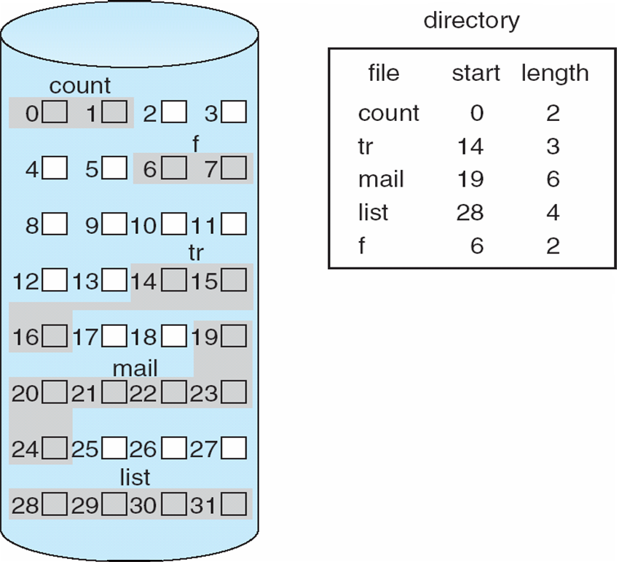
Contiguous Allocation
Mapping from logical to physical
Q
LA/512
R
Block to be accessed = Q + starting address
Displacement into block = R

Slide 47
Extent-Based Systems
Many newer file systems (i.e., Veritas File System) use a modified contiguous allocation scheme
Extent-based file systems allocate disk blocks in extents
An extent is a contiguous block of disks
Extents are allocated for file allocation
A file consists of one or more extents

Slide 48
Allocation Methods - Linked
Linked allocation – each file a linked list of blocks
File ends at nil pointer
No external fragmentation
Each block contains pointer to next block
No compaction, external fragmentation
Free space management system called when new block needed
Improve efficiency by clustering blocks into groups but increases internal fragmentation
Reliability can be a problem
Locating a block can take many I/Os and disk seeks

Slide 49
Allocation Methods – Linked (Cont.)
FAT (File Allocation Table) variation
Beginning of volume has table, indexed by block number
Much like a linked list, but faster on disk and cacheable
New block allocation simple

Slide 50
Linked Allocation
Each file is a linked list of disk blocks: blocks may be scattered anywhere on the disk
block =
pointer
Mapping
Q
LA/511
R
Block to be accessed is the Qth block in the linked chain of blocks representing the file.
Displacement into block = R + 1
Notes:
‹#›

Slide 51
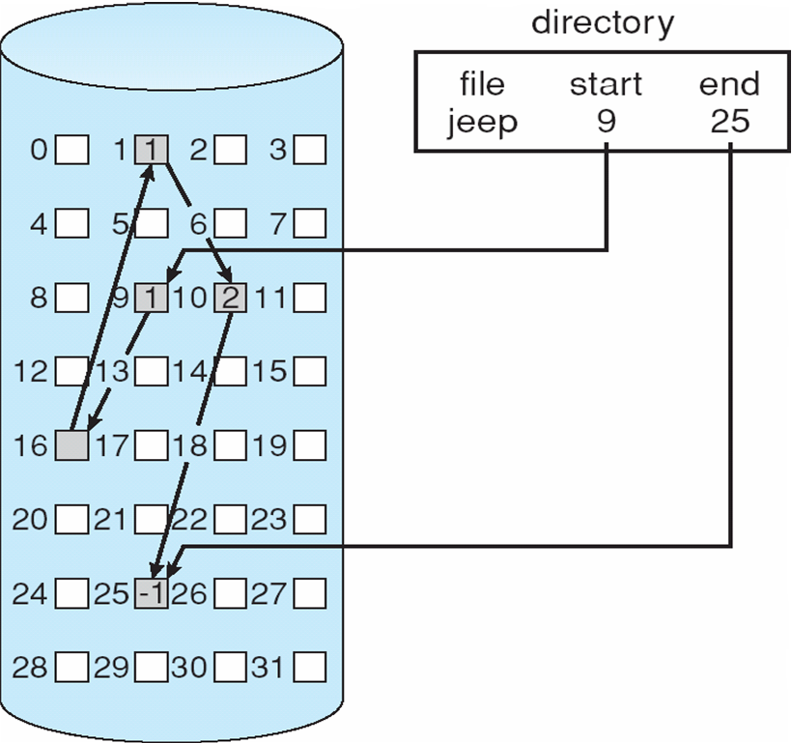
Linked Allocation
Notes:
‹#›

Slide 52
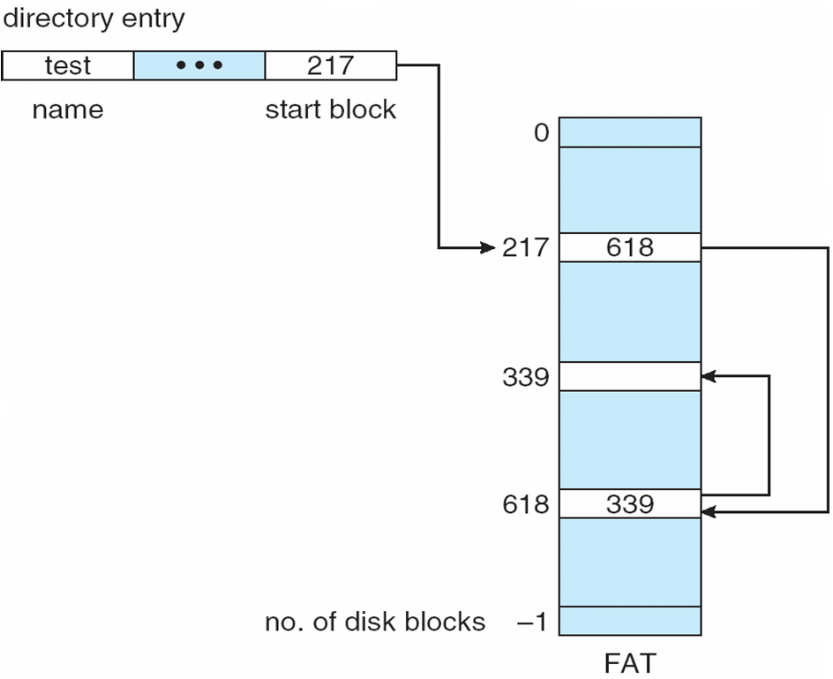
File-Allocation Table

Slide 53
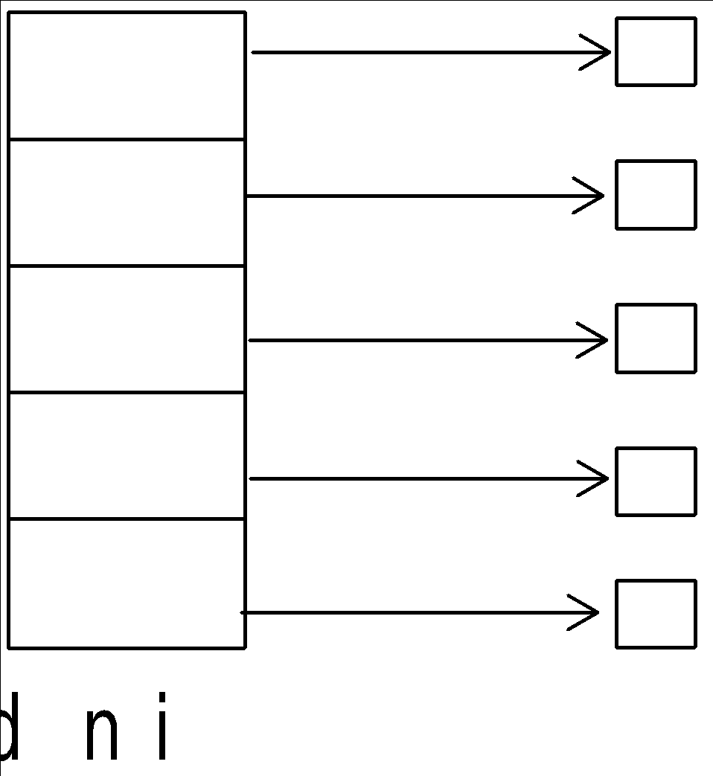
Allocation Methods - Indexed
Indexed allocation
Each file has its own index block(s) of pointers to its data blocks
Logical view

Slide 54
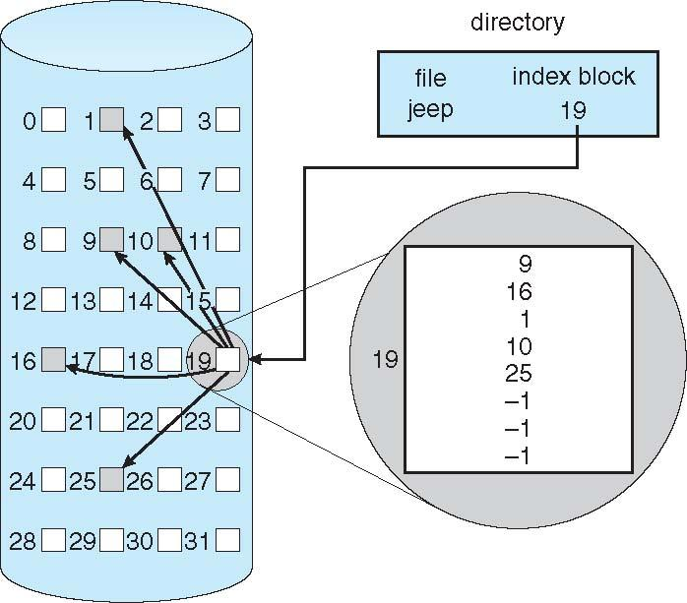
Example of Indexed Allocation

Slide 55
Indexed Allocation (Cont.)
Need index table
Random access
Dynamic access without external fragmentation, but have overhead of index block
Mapping from logical to physical in a file of maximum size of 256K bytes and block size of 512 bytes. We need only 1 block for index table
Q
LA/512
R
Q = displacement into index table
R = displacement into block

Slide 56
Indexed Allocation – Mapping (Cont.)
Mapping from logical to physical in a file of unbounded length (block size of 512 words)
Linked scheme – Link blocks of index table (no limit on size)
Q₁
LA / (512 x 511)
R₁
Q₁ = block of index table
R₁ is used as follows:
Q₂
R₁ / 512
R₂
Q₂ = displacement into block of index table
R₂ displacement into block of file:

Slide 57
Indexed Allocation – Mapping (Cont.)
Two-level index (4K blocks could store 1,024 four-byte pointers in outer index -> 1,048,567 data blocks and file size of up to 4GB)
Q₁
LA / (512 x 512)
R₁
Q₁ = displacement into outer-index
R₁ is used as follows:
Q₂
R₁ / 512
R₂
Q₂ = displacement into block of index table
R₂ displacement into block of file:

Slide 58
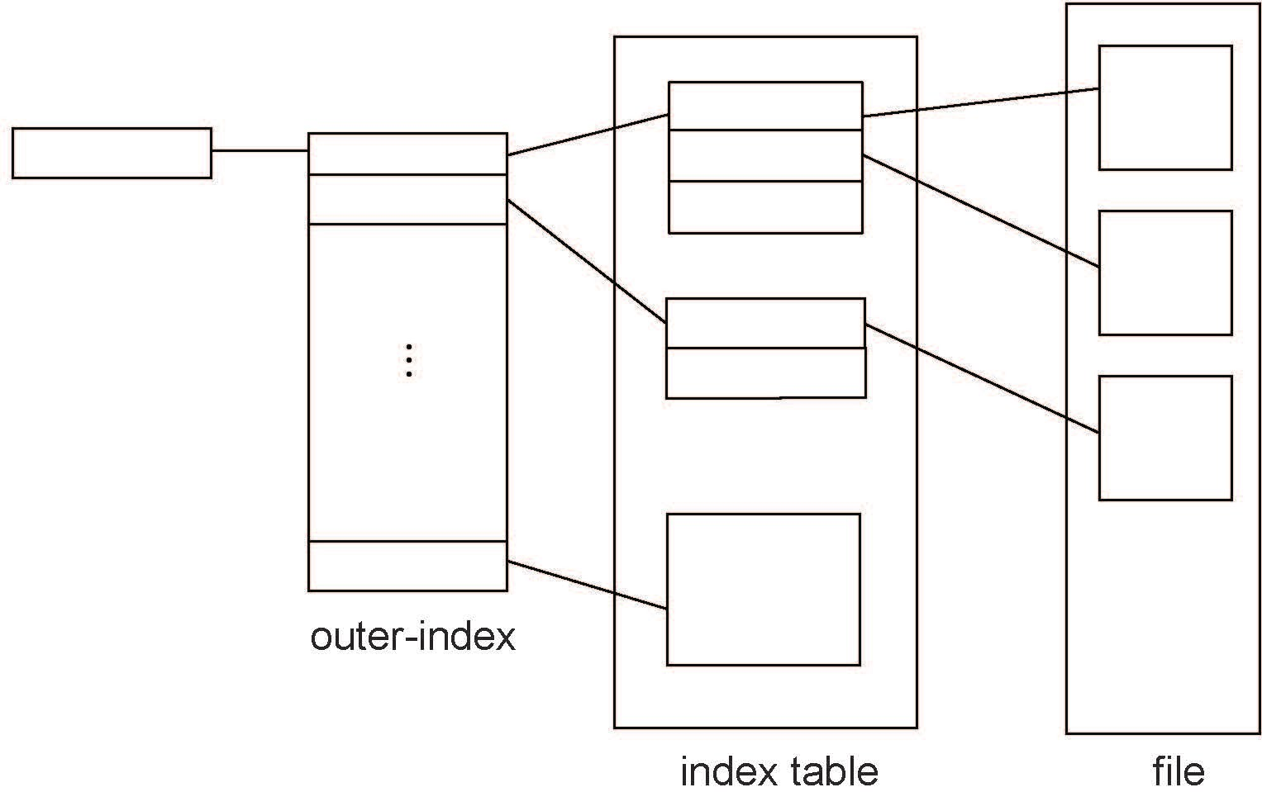
Indexed Allocation – Mapping (Cont.)

Slide 59
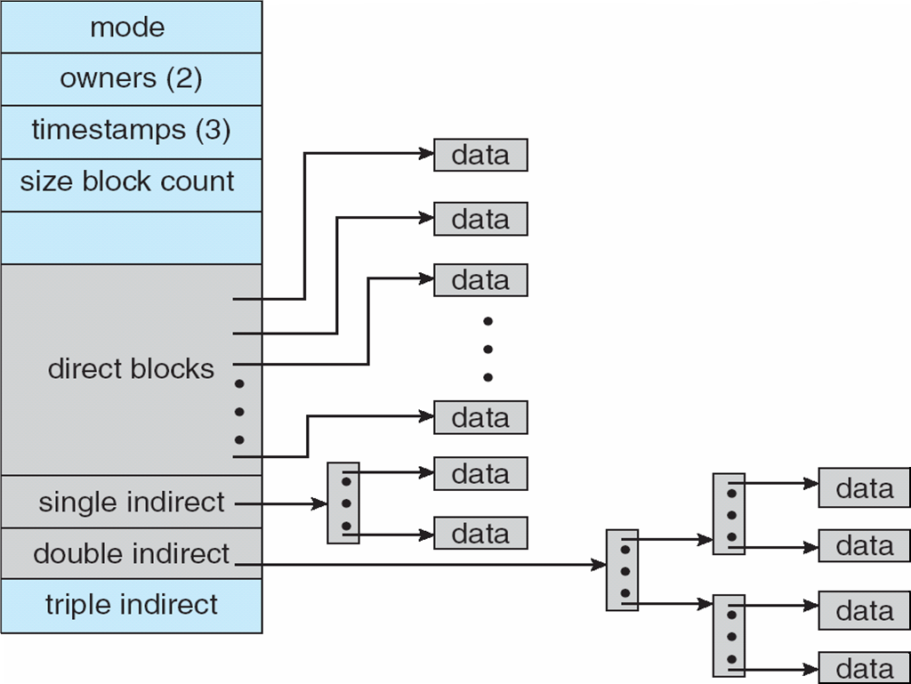
Combined Scheme: UNIX UFS
4K bytes per block, 32-bit addresses
More index blocks than can be addressed with 32-bit file pointer

Slide 60
Performance
Best method depends on file access type
Contiguous great for sequential and random
Linked good for sequential, not random
Declare access type at creation -> select either contiguous or linked
Indexed more complex
Single block access could require 2 index block reads then data block read
Clustering can help improve throughput, reduce CPU overhead

Slide 61
Performance (Cont.)
Adding instructions to the execution path to save one disk I/O is reasonable
Intel Core i7 Extreme Edition 990x (2011) at 3.46Ghz = 159,000 MIPS
http://en.wikipedia.org/wiki/Instructions_per_second
Typical disk drive at 250 I/Os per second
159,000 MIPS / 250 = 630 million instructions during one disk I/O
Fast SSD drives provide 60,000 IOPS
159,000 MIPS / 60,000 = 2.65 millions instructions during one disk I/O

Slide 62
Free-Space Management
File system maintains free-space list to track available blocks/clusters
(Using term “block” for simplicity)
Bit vector or bit map (n blocks)
0
1
2
n-1
…
1 ⇒ block[i] free
0 ⇒ block[i] occupied
bit[i] =

Block number calculation
(number of bits per word) *
(number of 0-value words) +
offset of first 1 bit
CPUs have instructions to return offset within word of first “1” bit

Slide 63
Free-Space Management (Cont.)
Bit map requires extra space
Example:
block size = 4KB = 2¹² bytes
disk size = 2⁴⁰ bytes (1 terabyte)
n = 2⁴⁰/2¹² = 2²⁸ bits (or 32MB)
if clusters of 4 blocks -> 8MB of memory
Easy to get contiguous files

Slide 64
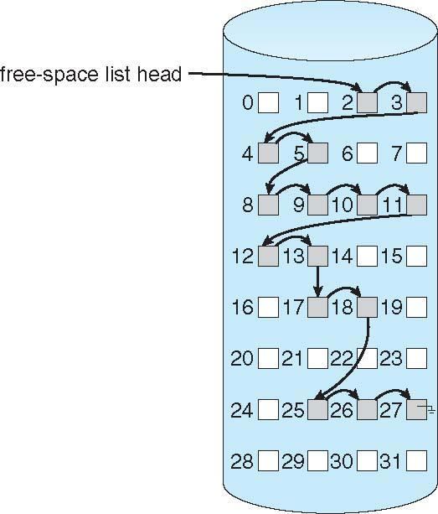
Linked Free Space List on Disk
Linked list (free list)
Cannot get contiguous space easily
No waste of space
No need to traverse the entire list (if # free blocks recorded)

Slide 65
Free-Space Management (Cont.)
Grouping
Modify linked list to store address of next n-1 free blocks in first free block, plus a pointer to next block that contains free-block-pointers (like this one)
Counting
Because space is frequently contiguously used and freed, with contiguous-allocation allocation, extents, or clustering
Keep address of first free block and count of following free blocks
Free space list then has entries containing addresses and counts

Slide 66
Free-Space Management (Cont.)
Space Maps
Used in ZFS
Consider meta-data I/O on very large file systems
Full data structures like bit maps couldn’t fit in memory -> thousands of I/Os
Divides device space into metaslab units and manages metaslabs
Given volume can contain hundreds of metaslabs
Each metaslab has associated space map
Uses counting algorithm
But records to log file rather than file system
Log of all block activity, in time order, in counting format
Metaslab activity -> load space map into memory in balanced-tree structure, indexed by offset
Replay log into that structure
Combine contiguous free blocks into single entry

Slide 67
Efficiency and Performance
Efficiency dependent on:
Disk allocation and directory algorithms
Types of data kept in file’s directory entry
Pre-allocation or as-needed allocation of metadata structures
Fixed-size or varying-size data structures

Slide 68
Efficiency and Performance (Cont.)
Performance
Keeping data and metadata close together
Buffer cache – separate section of main memory for frequently used blocks
Synchronous writes sometimes requested by apps or needed by OS
No buffering / caching – writes must hit disk before acknowledgement
Asynchronous writes more common, buffer-able, faster
Free-behind and read-ahead – techniques to optimize sequential access
Reads frequently slower than writes

